Slide 1
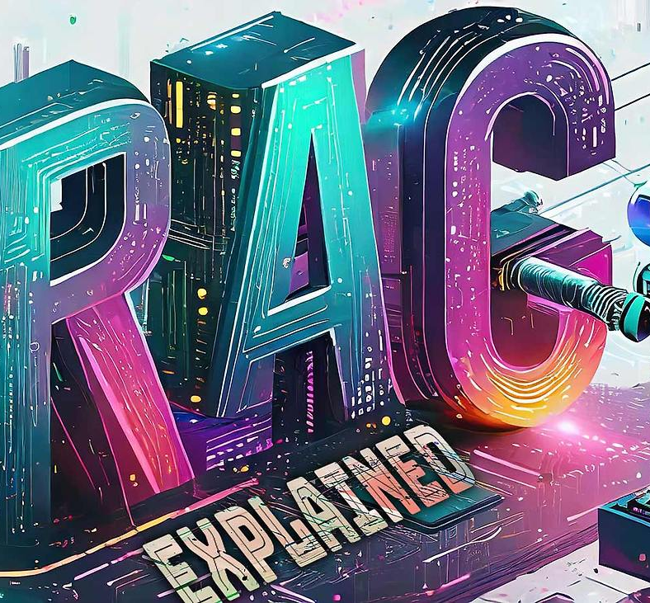
Case Study Analysis of the Retrieval Augmented Generation Tool Verba
6253-ITAI-2372
Alfredo Garza, Richard Rodriguez, Olaleye Bakare, Khizar Khan
16-Jul-2025
This Photo by Unknown Author is licensed under CC BY

Slide 2

Agenda
RAG Architecture
Demo
Verba - application architecture overview
Verba - processes
Verba - tech stack
Deployment challenges and solutions
Key concepts:
chunking, tokenization, and embeddings
Deployment
Lessons learned

Slide 3
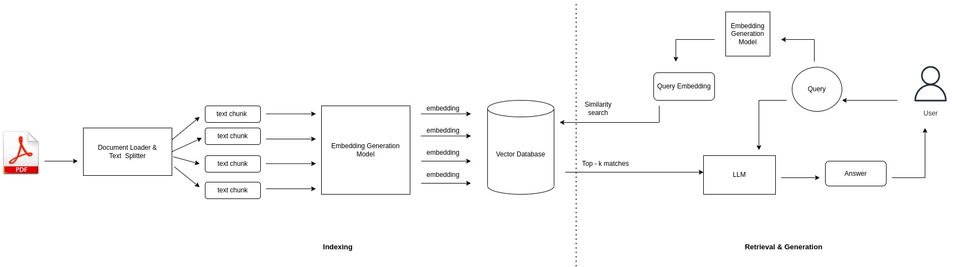
RAG Architecture

Slide 4
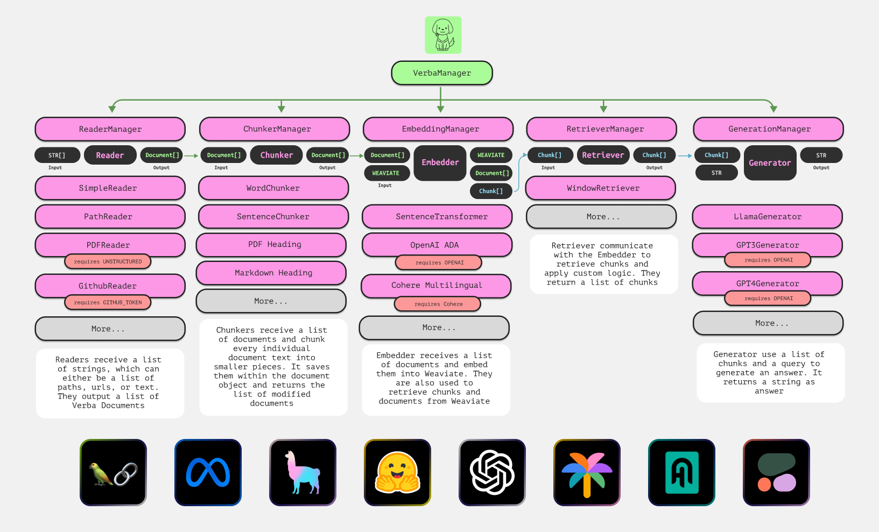
Verba Modular Architecture
Verba’s modular architecture breaks down the RAG pipeline into specialized managers—each handling a key part of the process.
VerbaManager: Oversees the entire workflow and coordinates modules
ReaderManager: Parses input into structured VerbaDocument objects
ChunkerManager: Splits documents into semantic chunks for embedding
EmbeddingManager: Converts chunks into vectors and stores them in Weaviate
RetrieveManager: Finds relevant chunks based on query embeddings
GenerationManager: Synthesizes responses using LLMs like Llama3
Notes:
Each manager is modular and can be extended or replaced independently. This design supports scalability and experimentation with different models or chunking strategies.
Verba’s architecture is optimized for semantic search and grounded generation.
The pipeline is orchestrated via FASTAPI, allowing easy integration with frontend tools.

Slide 5
Understanding Verba
Verba uses a Retrieval-Augmented Generation pipeline powered by Llama3 to deliver grounded, context-aware responses.
Documents are chunked, tokenized, embedded, and stored in Weaviate
User queries are changed into vectors and matched to stored chunks
Llama3 (8B/70B) is instruction-tuned for chat and runs locally via Ollama
Results are returned in natural language, grounded in source content
[Document Upload]
↓[Chunk → Tokenize → Embed]
↓[Store in Weaviate]
↓[User Query → Embed → Match]
↓[Retrieve Chunks → Generate Response]
Icon Index:
LangChain, Meta, LlamaIndex, Hugging Face, OpenAI, Google PaLM, Haystack, cohere-ai
Notes:
Documents are chunked, tokenized, embedded, and stored in Weaviate
User queries are embedded and matched to stored vectors
Relevant chunks are retrieved and passed to Llama 3 for generation
Llama 3 (8B/70B) is instruction-tuned for chat and runs locally via Ollama
Results are returned in natural language, grounded in source content
Verba supports multiple chunking strategies: token-based, sentence-based, semantic, recursive.
Chunking is a critical pre-processing step before embedding and storage.

Slide 6

Verba Storage: Fast and Flexible
Verba uses Weaviate to store embedded vectors, raw text, and metadata—making retrieval fast, flexible, and context-aware
Stores embeddings for semantic search
Optionally stores raw text for reference or output
Uses metadata to filter, categorize, and organize content
Supports fast similarity search using vector indexes
Notes:
Metadata can include source type, document title, tags, or timestamps.
Raw text storage is optional and can be used for traceability or auditability.
Embeddings are stored using HNSW indexing for fast retrieval.
Weaviate’s schema allows for flexible data modeling and filtering

Slide 7
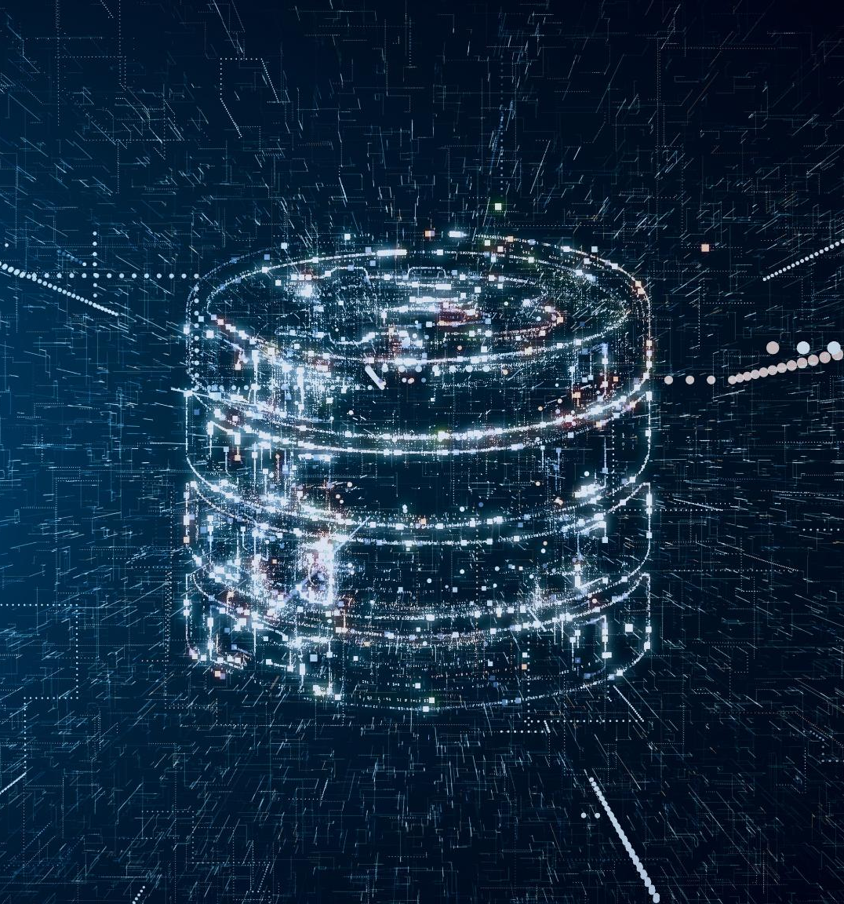
Comparing Tokenization and Vector Search
Verba bridges traditional token-based processing with modern vector search—making retrieval smarter and more context-aware.
Tokenization splits text into smaller units for preprocessing
Embedding models convert tokens into high-dimensional vectors
Vectors are saved in Weaviate; along with the original text and helpful metadata
Semantic search retrieves meaning-based matches—not just exact terms
Notes:
Tokenization is essential for preparing text for embedding, but it’s limited to surface-level structure.
Vector search uses Approximate Nearest Neighbor (ANN) algorithms to find conceptually similar content.
Verba stores both vectors and metadata, enabling filtered and contextual retrieval.
This hybrid approach allows Verba to answer nuanced queries like “examples of ethical AI in entertainment” even if those exact words aren’t present.

Slide 8

Verba Tech Stack
Verba combines modular tools and flexible deployment options to support semantic search and generation across diverse environments.
Frontend: Next.JS for user interface
Backend: FASTAPI for pipeline orchestration
Vector DB: Weaviate for storing and searching embeddings
LLMs: Ollama (local) and cloud-based models like OpenAI and Cohere
Deployment: pip, Docker, and Kubernetes for flexible setup for dev, test and production
Notes:
Ollama uses Meta’s Llama 3 models (8B and 70B), optimized for chat and instruction tuning. Verba supports local LLMs via Ollama and cloud-based models for flexibility.
Docker is preferred for deployment due to Python/Weaviate compatibility issues on Windows.
Kubernetes enables production-grade scaling and orchestration.
Pip install: `pip install goldenverba`; Docker: `docker compose --env-file up -d –build`

Slide 9

Deploying Verba
There are three deployment options for Verba:
Install via pip
pip install goldenverba
Build from Source
git clone https://github.com/weaviate/Verba pip install -e
Use Docker for Deployment
docker compose up –d\
OR
docker compose --env-file goldenverba/.env up -d --build
Notes:
Ollama can be installed locally or inside Docker to run LLMs like Llama 3.
Verba requires Python ≥3.10.0 and <3.13.0 for compatibility.
Docker is preferred due to limitations with Python-based deployment and Weaviate on Windows.
WSL (Windows Subsystem for Linux) provides a full Linux environment without needing a VM.
Kubernetes enables horizontal scaling and orchestration in production environments.

Slide 10

References
Geh, R. L., Zhang, H., Ahmed, K., Wang, B., & Van den Broeck, G. (2025, June 26). The impact of tokenization methods on language models. Simple Science. https://scisimple.com/en/articles/2025-06-26-the-impact-of-tokenization-methods-on-language-models--a3z2j85
APXML. (n.d.). Effect of tokenization on perplexity. In How to build a large language model (Chapter 21). https://apxml.com/courses/how-to-build-a-large-language-model/chapter-21-intrinsic-evaluation-metrics/effect-tokenization-perplexity
Hudson, M. (2024, February 29). Retrieving “adjacent” chunks for better context [Forum post]. Weaviate Community Forum. https://forum.weaviate.io/t/retrieving-adjacent-chunks-for-better-context/1603
Theja, R. (2023, October 5). Evaluating the ideal chunk size for a RAG system using LlamaIndex. LlamaIndex. https://www.llamaindex.ai/blog/evaluating-the-ideal-chunk-size-for-a-rag-system-using-llamaindex-6207e5d3fec5
Weaviate. (n.d.). Verba: Modular RAG pipeline for semantic search and generation [Software]. GitHub. Retrieved July 7, 2025, from https://github.com/weaviate/Verba
Weaviate. (n.d.). Vectors – An overview. Weaviate Documentation. https://docs.weaviate.io/academy/theory/hello_weaviate/overview_vectors
Weaviate. (n.d.). Vectorizer and vector index config. Weaviate Documentation. https://docs.weaviate.io/weaviate/manage-collections/vector-config
DataStax. (n.d.). What is a vector index? DataStax. Retrieved July 6, 2025, from https://www.datastax.com/guides/what-is-a-vector-index
NVIDIA RAPIDS. (n.d.). Vector databases vs. vector search. RAPIDS cuVS Documentation. Retrieved July 6, 2025, from https://docs.rapids.ai/api/cuvs/stable/vector_databases_vs_vector_search/
Microsoft. (2024). Copilot in PowerPoint: Image generation and design layout tools. Microsoft Support. https://support.microsoft.com/en-us/office/copilot-in-powerpoint
Notes:
This slide is reserved for listing all references used in your presentation. Ensure you follow the appropriate citation style (e.g., APA, MLA, Chicago). Include all sources such as books, articles, websites, and any other resources. Proper referencing adds credibility and helps avoid plagiarism.

